Slide 1
Have you ever wondered how you can actively participate in the renewable energy revolution while also contributing to a greener and more sustainable future?

Slide 2
Table of contents
01
Problem Specifications
02
Target Market
03
Prototype Demonstration
04
Innovative features
05
06
Future Enhancement
Key Benefits
07
Conclusion

Slide 3

Problem Specification for Renewable Energy Trading Platform
Lack of transparency and trust
Complex Energy Trading Process
Inconsistent Pricing and Payments
Environmental Impact Awareness
Education and Awareness

Slide 4
Target Market
Energy Consumers
Local Communities and Microgrids
Renewable Energy Producers
Pro-Sustainability Organizations

Slide 5
Prototype Demonstration

Slide 6
Innovative Features
Smart Matching Algorithm
Dynamic Pricing Model
Blockchain-powered Transactions
Peer-to-Peer Energy Swapping
Predictive Analytics
Real-time Energy Footprint Tracking

Slide 7
Key Benefits
- Empowering Energy Independence
- Promoting Sustainability & Environmental Impact
- Cost Savings and Economic Efficiency
- Innovation in Energy Trading
- Technological Advancement

Slide 8
Future Enhancements
Artificial Intelligence for Energy Forecasting
Peer-to-Peer Energy Trading Communities
Global Expansion and Interoperability

Slide 9
"Investing in renewable energy today is not just about powering our homes and businesses; it's an investment in a brighter, cleaner, and more sustainable future for generations to come."

Slide 10

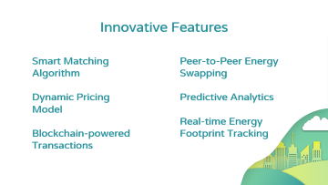
Thank you!

